Slide 1
The Limping Child: The good, bad and do not miss
Kelly Crown, PA-C
Pediatric Orthopedic Surgery

Slide 2
Disclosures
I have no relevant financial relationships with the manufacturer(s) of any commercial product(s) and/or provider(s) of commercial services discussed in this CME activity.
I do not intend to discuss an unapproved/investigative use of a commercial product/device in my presentation

Slide 3
Objectives
Learn to recognize which pediatric limps are concerning and require urgent/emergent care.
Ultimately: When should you be concerned
Review the most common and the most concerning etiologies of pediatric limp
Learn how clinical, radiographic and lab values can help
you differentiate between these various etiologies

Slide 4
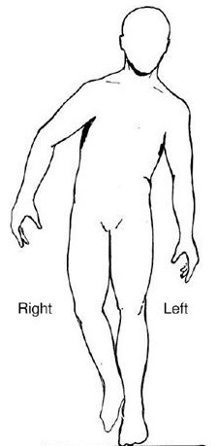
What is a Limp?
Asymmetric gait
Results in decreased time in the Stance Phase
When it’s painful = Antalgic Gait
Painless: Typically Trendelenburg Gait seen

Slide 5
BIGGEST TAKE AWAY
When a child says they have
knee pain…..
ALWAYS EXAMINE THE HIPS

Slide 6
Differential Diagnosis
Toddler (1-3)
Transient Synovitis Septic Arthritis Toddler’s Fracture CP DDH (Hip Dysplasia) JRA (Juvenile Rheumatoid Arthritis)
Child (4-12)
Transient Synovitis Septic Arthritis Osteomyelitis Legg-Calve-Perthes Leg Length Discrepancy Sever’s Disease Kohler’s Disease
Teen (13-18)
SCFE Dysplasia Tarsal Coalition Osgood-Schlatter Disease
All ages: Tumors, Trauma

Slide 7
Septic Arthritis #1 thing you MUST rule this out in all limping kids
Serious bacterial infection within the joint
Delay in treatment → cartilage damage, AVN, osteomyelitis
Hematogenus spread
Neonates: Group B Strep, Gram Negative Bacteria
Infants: MSSA, H. Influenza
Children: MSSA, Salmonella
Adolescents: MSSA, Gonorrhea
Can affect any body part and kids of any age but 50% are under the age of 2
0-2 y/o Hips 50%
3+ Knees 50%, Hip 20%
SURGICAL EMERGENCY

Slide 8
Septic Arthritis
Symptoms
Physical Exam
Refuse to bear weight or limp
Knee or hip pain
Fever
NO injury
No improvement with NSAIDs/Motrin Challenge
Febrile or low grade fever
Toxic/sick looking
Neonates less likely to be toxic
SEVERE pain with passive ROM.
Positive Log Roll (hips)
Asymmetry in motion
Very hesitant to let you examine them
Hip held in flexion and ER
Can have TTP, erythema and when severe, visible effusion

Slide 9
Kocher Criteria
Used to identify septic hip arthritis vs. transient synovitis
# Criteria Met | Percentage chance of having Septic Arthritis
1 | 3%
2 | 40%
3 | 93%
4 | 99%
1. Refusal to bear weight
2. Fever >38.5°C (101.3°F)
3. WBC >12,000 cells/uL
4. ESR >40 mm/h
**CRP >20 mg/L or >2mg/dL **
(not part of original criteria, but shown to be most reliable indicator)
(J. Bone Joint Surg. Am. 1999;81:1662-70)

Slide 10
Septic Arthritis
Tests
Treatment
CBC, CRP, ESR
*Kocher Criteria
Xray: Pelvis AP/Frog View
Normal doesn’t mean something isn’t wrong.
Late sign is narrowing, edema and ANV/collapse of the femoral head
Ultrasound if 2+ Kocher Criteria
MRI more sensitive but can delay treatment
Aspiration
>50,000 cells/mm³, >75% segmented neutrophils
Positive gram stain
EITHER → SURGERY
EMERGENT SURGERY for I&D
Sometimes, repease I&D’s are nessesary
continue to follow the CRP
If it’s increasing, take back to surgery
6 weeks IV antibiotics

Slide 11
Transient (Toxic) Synovitis * No. 1 Cause of limp/hip pain in children age 2-8
Self-limited inflammatory joint condition
Most commonly affects the hip
Most commonly complain of “Knee/Thigh Pain”
Males 2:1
Diagnosis of Exclusion
MUST RULE OUT SEPTIC ARTHRITIS
No single laboratory or imaging study will be definitive to confirm or exclude transient synovitis.

Slide 12
Transient (Toxic) Synovitis
Symptoms
Physical Exam
Limp or refuse to bear weight
Knee or hip pain
REMOTE history of an ILLNESS
1 to 5 weeks ago
Viral or bacterial
NO injury
Typically worse in the morning
AFEBRILE or low grade fever (99-101)
Limp improves with NSAIDs
Afebrile or low grade fever
Not toxic/sick looking
Passive ROM: Asymmetry +/- guarding and pain
Hips: decreased Abduction and Internal Rotation (+Impingement)
Knee: lack full flexion +/- lack terminal extension
No TTP, No erythema, No visible effusion

Slide 13
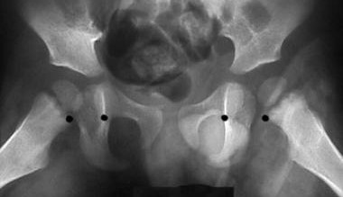
Transient (Toxic) Synovitis
Tests
Treatment
CBC, CRP, *ESR
Normal
Xray: Pelvis AP/Frog View
Normal vs slight widening
Ultrasound
Self limiting
Symptoms can resolve in a week or as long as 4-5 weeks
The faster the patient is put on Motrin, TID, the faster their pain/symptoms resolve
0.43
0.49

Slide 14
Toddler’s Fractures
Low energy injury
i.e.) Trip and fall over a toy
Classic: going down a slide
Age < 3y/o
Walking toddlers: low likelihood of child abuse
If not walking, suspect abuse
STABLE fractures: commonly spiral/oblique fracture of the tibia
Other common locations
1st Metatarsal
Tibia +/- Fibula
Femur (higher suspicion for abuse)

Slide 15
Toddler’s Fractures
Symptoms
Physical Exam
Limp or refuse to bear weight
Crawling: tibia, fibula fx
Not walking: tibia or femur fx
Walk on lateral aspect of foot or on their heel: Metatarsal fx
Injury
AFEBRILE
Afebrile, Nontoxic
BONY TTP and/or pain with rotation
Passive ROM: Asymmetry +/- guarding and pain
Pain with hip ROM: femur
Pain with knee ROM: distal femur or proximal tibia
Pain with ankle ROM: distal tibia/fibula

Slide 16
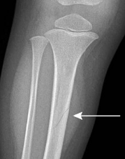
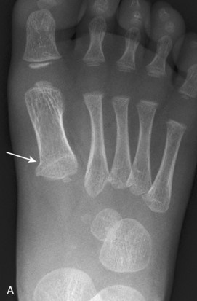
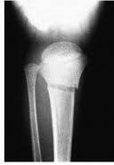
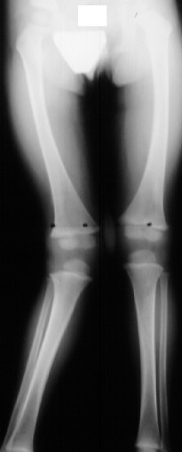
Toddler’s Fractures
Tests
Treatment
Xray: nondisplaced subtle fracture
Sometimes a clinical diagnosis
Might not be visible for a week
Late finding is new periosteal reaction
Self limiting
Cast vs observation
Heal in 2-4 weeks
Limp up to 6 weeks
Typically no long term sequela
Proximal Tibia (Cozen Fracture) slight risk of developing Cozen Deformity (Valgus deformity of the knee 1-2 years after)

Slide 17
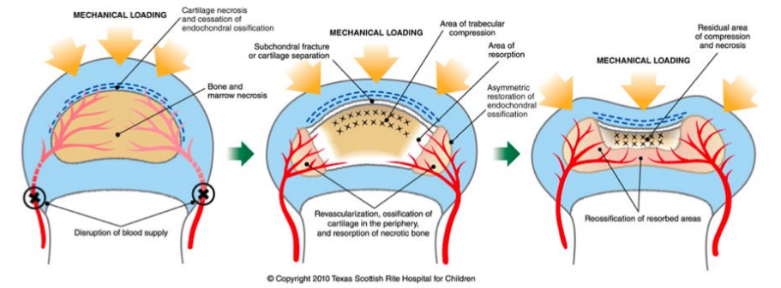
Leg-Calve-Perthes aka Perthes
Avascular Necrosis of the Femoral Head
Unknown etiology
Can cause permanent deformity of the femoral head
Earlier treatment, minimizes this risk of permanent deformity
Boys 5:1 more likely
Age typically 4-7
Age <6 better prognosis
Age > 8 worse prognosis

Slide 18
Leg-Calve-Perthes
Symptoms
Physical Exam
PAINLESS LIMP (first symptom)
+/- Hip, thigh or Knee
NO injury
Afebrile
Symptoms Wax and Wane
Worse during or after activities
Improve with rest and NSAIDs
Antalgic gait
Trendelenburg gait late finding once femoral head collapses
Decreased hip ROM
Loss of Abduction and Internal Rotation
Hip flexion contracture
Limp Length Discrepancy (late finding)
Hip contracture can exacerbate this

Slide 20
Leg-Calve-Perthes
Tests
Treatment
Xray
Normal first 3-6mo
Early signs is medial joint space narrowing, sclerosis and flattening of the femoral head
MRI is the gold standard for diagnosis
Follow with serial xrays
**type of treatment recommended is based on patient’s age, stage of disease, and radiographic class**
MAIN GOALS
Symptomatic relief: NSAIDs
Protected weight bearing through the acute phase with crutches +/- abduction brace
Can take 18mo to 2 years to fully subside

Slide 21
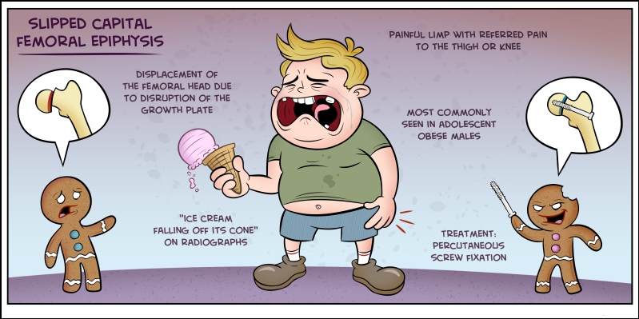
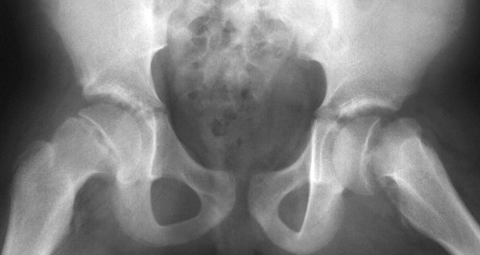
SCFE (Slipped Capital Femoral Epiphysis)
Femoral head Slips off the Femoral neck
“Ice cream falling off the cone”
Most common adolescent hip disorder
During rapid growth
Males: 13.4 y/o (12-16)
Females 12.2 y/o (10-14)
Younger: Hypothyroid
**Obesity**
Male (2 to 1.5 ratio)
Unilateral (40% BL)
SURGICAL EMERGENCY
Jorge Muniz, PA-C, Medcomic.com

Slide 22
SCFE
Symptoms
Physical Exam
PAINFUL LIMP
Acute or chronic
Hip pain (L>R)
Commonly get referred thigh or
knee pain
+/- minor injury
Afebrile
Gait
Antalgic gait = Stable SCFE
NWB = Unstable SCFE
Decreased hip ROM
Loss of Internal Rotation
Obligatory ER with hip flexion
Guarding
Limp Length Discrepancy (unstable)
Short and Externally rotated

Slide 23
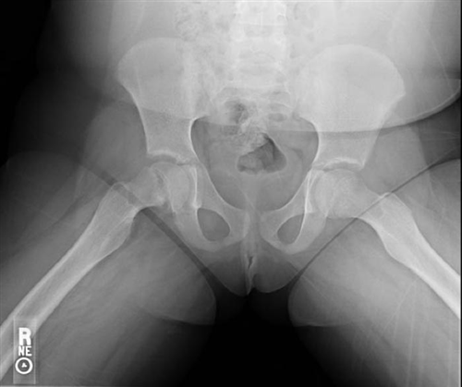
SCFE
Tests
Treatment
Xray Pelvis
AP & Frog-leg Lateral
Frog-leg best at subtle SCFE
MRI if nl Xray: can dx pre-slip
Physeal edema or widening
Percutaneous Screw Fixation
URGENT
Contralateral Pinning?
Correct the deformity after it heals
Minimal displacement: hip arthroscopy with chondroplasty (FAI surgery)
Displaced: Varus Derotational Osteotomy (VDRO)

Slide 24
Case 1: Left leg pain x 13 days. Hasn’t walked in 12 days
7 y/o Female No PMH
2 weeks ago fell from a seated position off a rocking chair. Walked and had no pain after the fall. Next morning woke up with left knee pain and wouldn’t walk
2 days later, had a tactile fever. Taken to local ER, Temp 100.4. Hip Xray Slight Narrowing. Positive for StrepA and put on Amoxicillin
Day 7 of her ABX develops a rash, back to urgent care. Still not walking! Temp 99. Thought to be a drug rash. Stopped the Amoxicillin and put on Ceftin.
CBC: elevated WBC (13.6), Anemic, Hgb 10.5, Hct 31.1, Platelets 724
PCP instructed the family OK not to take ABX since 7 days was sufficient

Slide 25
Case 1
Sees PCP the AM before coming to the ortho clinic, order labs
CBC: nl WBC (10), worsening anemia Hgb 9.1, Hct 28, Platelets 671
Sed Rate 95
DAY 13: Sees me
HASN’T WALKED IN 12 DAYS.
Parents still say that tactilely she is still febrile (don’t have a thermometer)
No improvement in pain with Motrin or Tylenol.
Any small movement, she cries in pain.

Slide 26
Case 1
Vitals
Temp 98.2 F (took motrin 2 hrs prior)
Unable to get height and weight because she refuses to stand
PE
Sitting in a baby stroller
Looks sick
SEVERE pain with even minor left hip ROM
Hip flexion contracture with obligatory ER
Full knee ROM without pain
TTP at Psoas

Slide 27
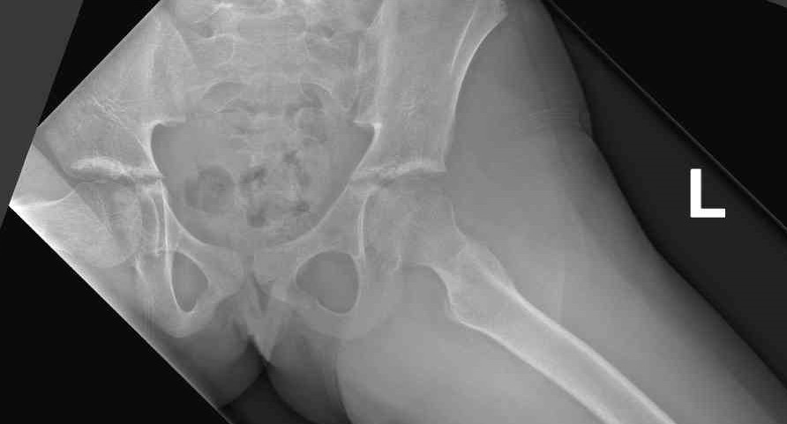
Day 4

Slide 28
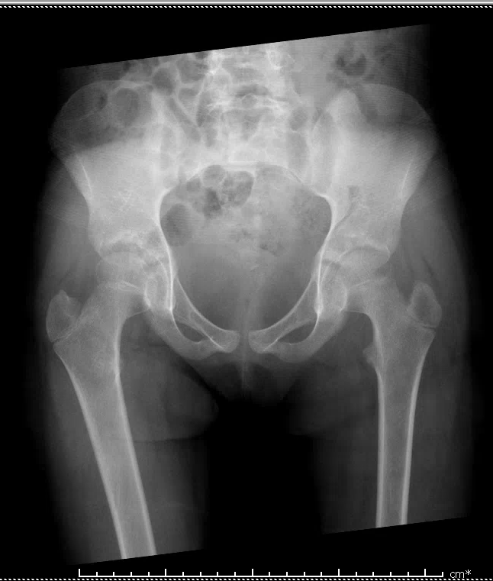
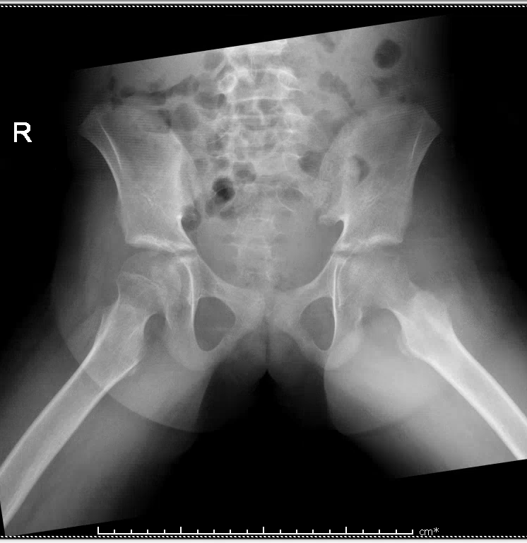
Day 13

Slide 29
Case 1
Admitted to Fairfax ED for STAT MRI with aspiration
Labs
WBC 14.12 4.80 - 13.00 x10 3/uL
Hgb 9.5 11.5 - 14.5 g/dL
Hematocrit 29.0 33.0 - 43.0 %
Platelets 681 140 - 400 x10 3/uL
CRP 6.3 0.0 - 0.8 mg/dL
ESR 99 0 - 20 mm/Hr

Slide 30
Kocher Criteria
Used to identify septic hip arthritis vs. transient synovitis
# Criteria Met | Percentage chance of having Septic Arthritis
1 | 3%
2 | 40%
3 | 93%
4 | 99%
1. Refusal to bear weight
2. Fever >38.5°C (101.3°F)
3. WBC >12,000 cells/uL
4. ESR >40 mm/h
**CRP >20 mg/L or >2mg/dL **
(not part of original criteria, but shown to be most reliable indicator)
(J. Bone Joint Surg. Am. 1999;81:1662-70)

Slide 31
Case 1
MRI
Septic arthritis with Psoas Abscess
URGENT I&D
Cartilage of her hip was gone, underlying osteomyelitis
6 weeks IV ABX

Slide 32
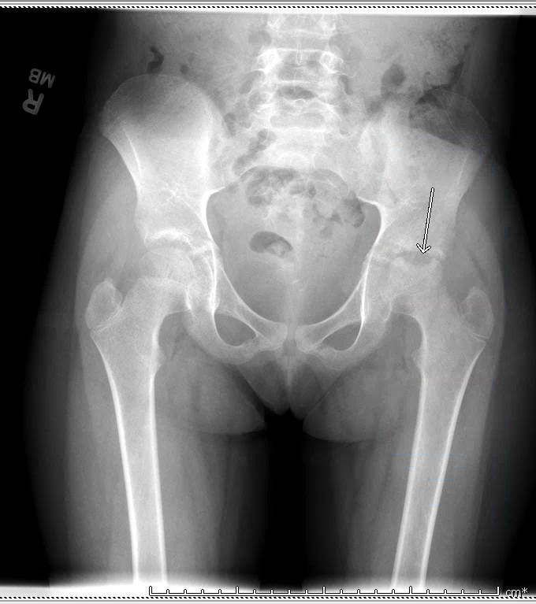
3 months post-op
Still has pain and limited hip ROM

Slide 33
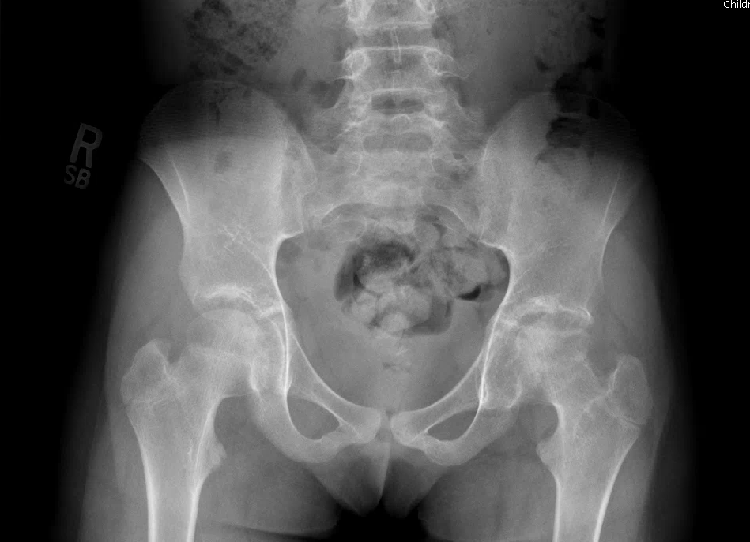
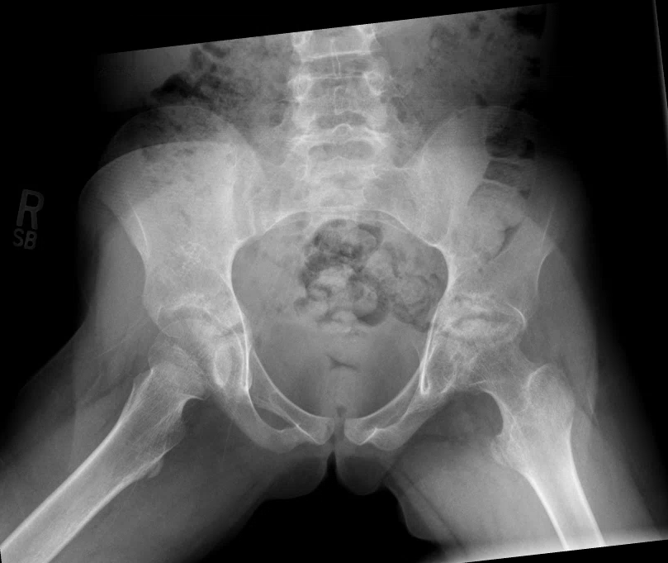
1 year post op

Slide 34
Case 2: Left hip pain x 2 weeks
11 y.o. female No PMH
Left hip pain x 2 weeks after a fall
jumping over hurdles at camp and landed on her LLE "awkwardly."
Pain= sharp, non-radiating, worse with movement
Able to walk
PE:
Vitals
5’3” 130lbs
Afebrile
AAO x 3, NAD
Slightly antalgic gait but FWB
TTP at the groin
Pain and Limited IR

Slide 35
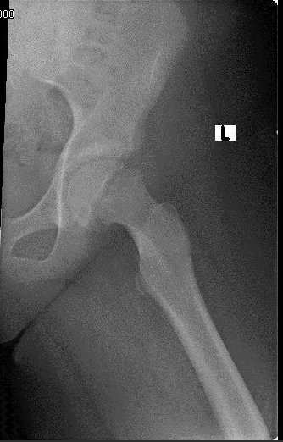

Slide 36
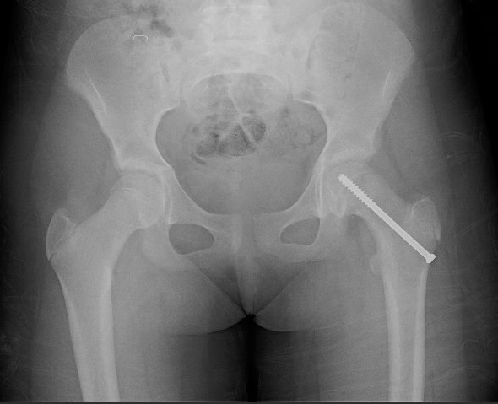
Case 2
URGENT Percutaneous Screw Fixation
7 weeks post-op
Pain free
FWB
Only lacked 10 degrees IR
Full abduction
CLEARED FOR ALL ACTIVITIES

Slide 37
Case 3: 1 year of left knee pain
16 y/o M with no PMH here for 2nd opinion
Left knee pain x 1 year after a twisting injury during soccer
Didn’t get treatment for 2 months
Was seen by an outside ortho group for concern for meniscus tear
MRI showed small lateral meniscus tear
Tx included rest, NSAIDs, corticosteroid injection and months of physical therapy
Physical Therapist noted that he had minimal hip ROM
Has had no hip pain x 2 months

Slide 38
Case 3
Vitals
5’7” 187lbs
Afebrile
PE
IR of the Right was 40, Left was 0 and with mild pain
Obligate ER of the left
Full knee ROM, negative McMurry
Gait: Significant Trendelenburg and External Foot progression of the left

Slide 39
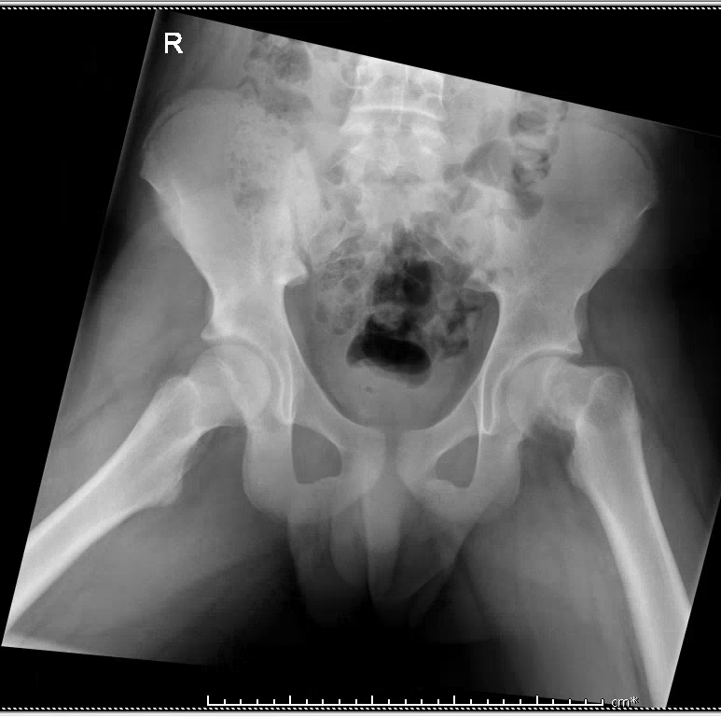

Slide 40
Case 3
TREATMENT
Option 1:
Percutaneous Screw Fixation
POSITVE: would stop further Slippage, minor surgery, WBAT after
NEGATIVE: wouldn’t correct the deformity, likely need a second surgery
Option 2:
VDRO (Valgus Derotational Osteotomy)
POSITIVE: Would correct the deformity and regain his motion
NEGATIVE: Major surgery, would be NWB for 4-6 week and not able to run for 12 weeks

Slide 41
They choose option 2 10 weeks post-op -now FWB -knee pain -recently started PT to help with his hip ROM and strength now that the osteotomy is healed

Slide 42
BIGGEST TAKE AWAY
When a child says they have
knee pain…..
ALWAYS EXAMINE THE HIPS

Slide 43
Thank you!
Questions?

